Slide 1
Simulated Mobile Money Platform with Machine Learning Fraud Detection
Atabisa Williams (UEB1107322), Aninakwa Desmond (UEB1106722), Oti Akwasi Latteh (UEB1100622)
Supervisor: DR. Samuel Tweneboah-Koduah
Department of Computer and Electrical Engineering, UENR

Slide 2
Presentation Outline
Introduction
Project Scope and Delimitations
Literature Review
System Methodology and Architecture
Implementation and System Integration
Experimental Results and Performance Evaluation
Discussion and Conclusion

Slide 3
Introduction
Mobile money (MoMo) has become the foundational financial infrastructure across Sub-Saharan Africa, replacing branch banking for millions of unbanked users.
Ghana alone processed over 6.8 billion transactions worth GHS 1.9 trillion+ in a single year [1].
This explosive transaction velocity has made mobile money ecosystems an attractive target for organized digital fraud [3], [4].
Two dominant threat categories confront MNOs today:
  Account Takeover Detection (ATOD)
  Transaction Anomaly Fraud
Static, rule-based defenses cannot adapt fast enough to these evolving attack patterns.
[1] Bank of Ghana Annual Payment Systems Report, 2023. [3] Arthur, Mensah & Agyepong, African Development Review, 2023. [4] Boateng et al., IEEE Access, 2022.

Slide 4
Problem Statement
Legacy MNOs rely on static, rule-based engines: fixed transfer caps, velocity counters, and blacklists [5].
Rule engines cannot distinguish a genuine session from one using stolen but valid credentials.
Two catastrophic fraud categories result:
  Account Takeover (ATOD): adversary hijacks the account, changes the PIN, and drains the wallet
  Transaction Anomaly: abnormal amounts, midnight transfers, rapid balance depletion [6], [7]
Rigid thresholds create high false positives or leave attack corridors wide open.

Slide 5
Research Objectives
Build a real-time ATOD engine: facial detection scan, Haversine geospatial velocity, credential-change monitoring
Train and deploy an XGBoost model on the Kaggle Africa-Mobile-Money-Fraud-Dataset for sub-10ms anomaly scoring
Engineer an 18-feature behavioral telemetry vector fusing hardware, network, and financial signals
Implement an autonomous zero-deduction defense policy with step-up MFA for borderline transactions
Deploy a real-time SOC portal with WebSocket alerts for human-in-the-loop dispute adjudication

Slide 6
Project Scope and limitations
In-Scope Focus Areas
  Real-Time Account Takeover Detection (ATOD): facial detection can, IP subnets, Haversine velocity breaches, rapid credential changes
  Transaction Anomaly ML Scoring: XGBoost evaluation of amount Z-scores, spending variance, midnight windows, and balance exhaustion
  Full-Stack End-to-End Simulation: client app, Node.js gateway, FastAPI ML service, and React SOC portal
Out-of-Scope Exclusions
  High-Risk Receiver / Mule Account Detection (graph-based clustering, AML networks)
  Carrier-Level SIM Swap Prevention (SS7 / Diameter signaling, carrier-side audits)
  Social Engineering and Voice Phishing Interception (vishing, smishing)
  Cross-Institutional AML Reporting (multi-year, multi-bank aggregation)

Slide 7
Literature Review
Mobile money evolved from telecom-driven financial inclusion to a systemically important national payment rail [2], [3]
Account takeover typically involves credential theft, device migration, and rapid PIN changes before fund exfiltration [5], [6]
Transaction anomalies show statistical outliers in amount, timing, and velocity that evade rule-based checks [7], [9]
XGBoost consistently outperforms conventional classifiers on imbalanced financial data [8], [13]
Research gap: prior studies treat ATOD and transaction-anomaly detection as separate domains, with no unified real-time, zero-deduction implementation, addressed in this thesis

Slide 8
Literature Review: Key Studies
Ref | Authors | Year | Focus Area | Journal | Key Finding | Relevance to This Study
[5] | Mensah, Arthur & Osei | 2023 | Account Takeover (ATOD) | Computers & Security | Static rules cannot flag hijacked sessions using valid credentials | Motivates the ATOD heuristic engine
[8] | Liu, Zhang & Wang | 2021 | XGBoost anomaly detection | Expert Systems w/ Applications | XGBoost outperforms conventional classifiers under extreme class imbalance | Basis for the transaction-scoring model
[11] | Tetteh, Sowah & Mills | 2023 | Real-time ML fraud architectures | IEEE IoT Journal | Most prior systems are offline/batch, not real-time | Justifies the sub-10ms inference design
[15] | Darkwah & Mensah | 2024 | SOC workflows | Computers & Security | Human-in-the-loop review improves fairness and auditability | Basis for the SOC portal design

Slide 9
System Methodology and Architecture
Design Philosophy
Zero-Trust, Defense-in-Depth: every transaction is treated as potentially compromised until verified through multiple independent security layers
Hybrid detection combining deterministic heuristic rules (ATOD engine) with probabilistic ML scoring (XGBoost regressor)
Five-Tier Microservice Architecture
Client Layer - React.js SPA with biometric enrollment and real-time WebSocket sync
API Gateway - Node.js/Express with JWT auth, ATOD interceptor middleware, and telemetry ingestion
ML Inference - FastAPI/Uvicorn hosting the serialized XGBoost model as an isolated microservice
Database - MongoDB Atlas storing users, transactions, fraud cases, and immutable audit logs
SOC Portal - Real-time fraud analyst dashboard with bi-directional WebSockets and forensic drawer
Dual Detection Pipeline
ATOD Heuristic Engine: device fingerprint check, Haversine velocity breach, credential-change monitoring, and account lockout triggers (<7 ms latency)
ML Anomaly Scorer: 18-feature telemetry vector scored by XGBoost into a continuous risk value [0.00–1.00]; Model A zero-deduction defense for high-risk transactions

Slide 10
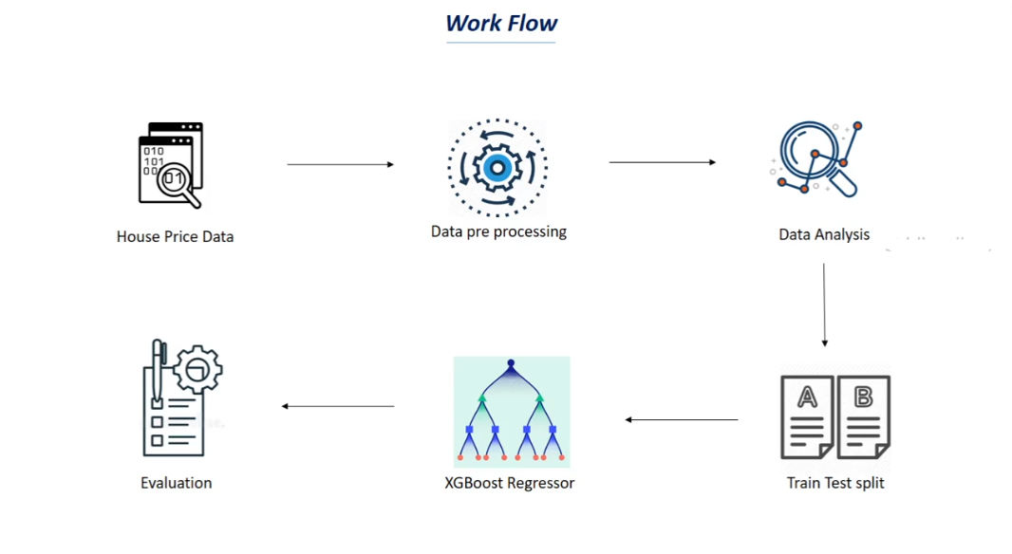
Machine Learning Workflow Pipeline
The diagram below illustrates the end-to-end machine learning workflow adopted in this project. Raw transaction data from the Kaggle Africa-Mobile-Money-Fraud-Dataset undergoes pre-processing (handling missing values, encoding categorical features, and normalizing numerical fields), followed by exploratory data analysis. The cleaned dataset is split into 80/20 train-test partitions before being fed into an XGBoost Regressor. The trained model is evaluated using MAE, RMSE, and R² metrics, then serialized and deployed as a real-time fraud scoring microservice via FastAPI.

Slide 11
Implementation and System Integration
Backend: Node.js 18 LTS + Express.js gateway - JWT auth, telemetry ingestion, ATOD interceptor middleware
ML Service: Python 3.10, FastAPI + Uvicorn hosting the serialized XGBoost model as an isolated microservice
Web Client: React.js single-page application with an automated step-up MFA challenge modal
Database: MongoDB Atlas - users, accounts, transactions, fraud_alerts, and audit_logs collections
SOC Admin Portal: React.js dashboard with bi-directional WebSockets, live KPI ribbon, and forensic drawer

Slide 12
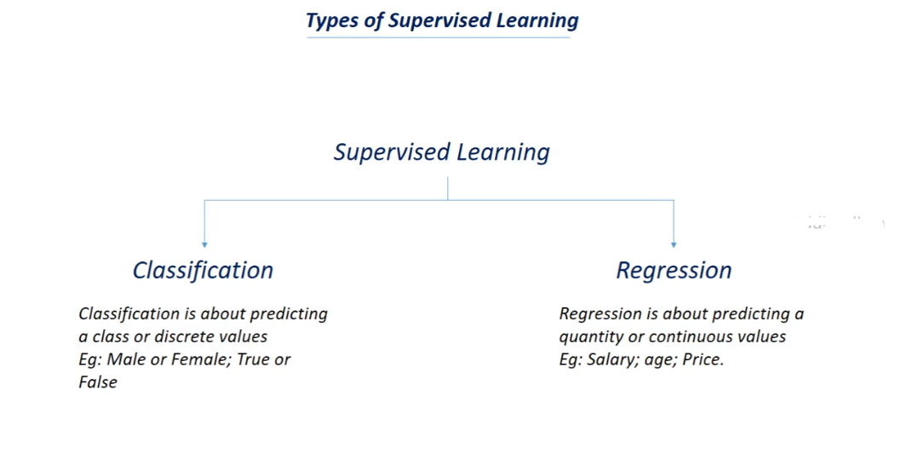
Supervised Learning: Classification vs. Regression
This project leverages supervised learning, the branch of machine learning where models are trained on labelled historical data to generalize predictions to unseen inputs. Supervised learning divides into two paradigms: Classification assigns discrete labels (e.g., fraud vs. legitimate), while Regression predicts continuous values (e.g., a risk score between 0.0 and 1.0). Our XGBoost model operates as a regressor, outputting a continuous fraud-risk score that is subsequently normalized via min-max scaling and mapped to four risk tiers (Low, Medium, High, Critical) to drive the Model A zero-deduction defense policy.

Slide 13
Experimental Results
Metric | Value
R2 error | 0.664
Mean square error | 1.892
Fraud Recall | 82.40%
Avg. ML Inference Latency | 6.8 ms

Slide 14
Discussion and Conclusion
Hybrid defense outperforms either approach alone: heuristics catch identity attacks in under 7ms; XGBoost resolves subtle behavioral drift
Zero-deduction policy is production-viable via a sidecar proxy and Kubernetes auto-scaling for peak MNO transaction loads
Must comply with Ghana's Data Protection Act (Act 843); SHAP explainability supports fair, auditable decisions
Key contributions: a unified ATOD + ML defense architecture, an 18-feature telemetry vector, a validated zero-deduction policy, and a real-time SOC portal
Limitations: trained on the Kaggle dataset only; pure USSD sessions lack rich browser telemetry
Future work: graph neural networks for mule detection, privacy-preserving federated learning, and edge AI deployment on handsets

Slide 15
THANK YOU

